Slide 1


Intelligent AI-Based Travel & Tourism Planner
Personalized Travel Itinerary Generator with AI Assistance
Prepared & Presented By
Kota Tejas Reddy
Agentic AI Developer

Slide 2

Abstract
Travel planning is often time-consuming and confusing, requiring visits to multiple websites. Manual planning can lead to higher costs and errors. Our project introduces an AI-driven solution that makes planning faster and smarter. It collects data, processes it, and provides instant suggestions. This makes traveling easier and more enjoyable for users.
Intelligent AI-Based Travel & Tourism Planner

Slide 3

Objectives
The aim of this project is to simplify trip planning with accurate, cost-effective, and personalized recommendations. By using AI, it saves time, reduces errors, and lets users focus on enjoying their journey.
Intelligent AI-Based Travel & Tourism Planner

Slide 4
Literature Review
Our AI system offers personalized, cost-effective, and dynamic travel planning unlike existing apps.
Existing Travel Apps | Proposed AI System
Manual searching required | Automated AI itinerary generation
Generic recommendations | Personalized to user preferences
Costly and may miss deals | Optimized cost-efficient planning
Less flexible, hard to re-plan | Dynamic re-planning in real time
Limited personalization | AI-driven insights and adaptability
Intelligent AI-Based Travel & Tourism Planner

Slide 5


Architecture
travel-planner/
├─ .env.example
├─ requirements.txt
├─ main.py
├─ routes.py
├─ models.py
├─ database.py
├─ llm_client.py
├─ logger.py
├─ postman_collection.json
Intelligent AI-Based Travel & Tourism Planner

Slide 6
Comparison of Manual Planning vs AI-based Planning
Time Taken | Several hours to days (research, booking) | Few minutes (automated)
Cost Efficiency | May miss cheaper options | Finds optimized deals
Personalization | Generic, depends on user’s research | Tailored to preferences
Accuracy | Prone to human error | Data-driven, highly accurate
Flexibility | Hard to re-plan quickly | Dynamic re-planning possibl
User Effort | High (multiple websites, calls) | Low (single interface)
Intelligent AI-Based Travel & Tourism Planner

Slide 7
Accuracy of Recommendations vs User Satisfaction
Metric
Accuracy (%) | User Satisfaction (%)
Destination Recommendation | 88% | 85%
Hotel Recommendation | 92% | 89%
Restaurant/Food Suggestion | 86% | 83%
Activity Planning | 90% | 87%
Transportation Planning | 84% | 82%
Overall | 88% | 85%
Intelligent AI-Based Travel & Tourism Planner

Slide 8
Modules
Suggestions, hotel recommendations, food options, and activity planning.
The project is divided into key modules such as destination suggestions, hotel recommendations, food options, and activity planning. It also includes transportation and re-planning features. Each module works independently yet integrates into a single platform. The features focus on saving time, cost, and effort. Together, they create a complete AI-based travel planner.
Focus on saving time, cost, and effort.
Intelligent AI-Based Travel & Tourism Planner

Slide 9
END POINTS
Method | Endpoint | Purpose
GET | /api/v1/locations | Get available locations (cities, states, countries).
POST | /api/v1/plan | Create a new travel plan (AI-generated itinerary).
GET | /api/v1/plan/{user_id} | Retrieve an existing travel plan by user_id.
POST | /api/v1/suggestions | Get tourist spots and hotel suggestions (low + high budget).
GET | /api/v1/search | Search travel plans by destination.
POST | /api/v1/feedback | Submit feedback (rating + comments) for a plan.
POST | /api/v1/group_trip | Register group trip details (travelers info).
POST | /api/v1/group-trip | Alternative endpoint for creating group trips.
POST | /api/v1/book | Book trip automatically (transport, hotel, restaurant).

Slide 10
Tourism Palces To Be Search
INDIAN CITIES | INDIA STATES | WORLD TOURISM
Delhi | Rajasthan | Paris
Mumbai | Kerala | New York
Chennai | Goa | London
Kolkata | Uttarakhand | Dubai
Hyderabad | Tamil Nadu | Rome
Bengaluru | Karnataka | Tokyo
Lucknow | Punjab | Sydney
Intelligent AI-Based Travel & Tourism Planner

Slide 11
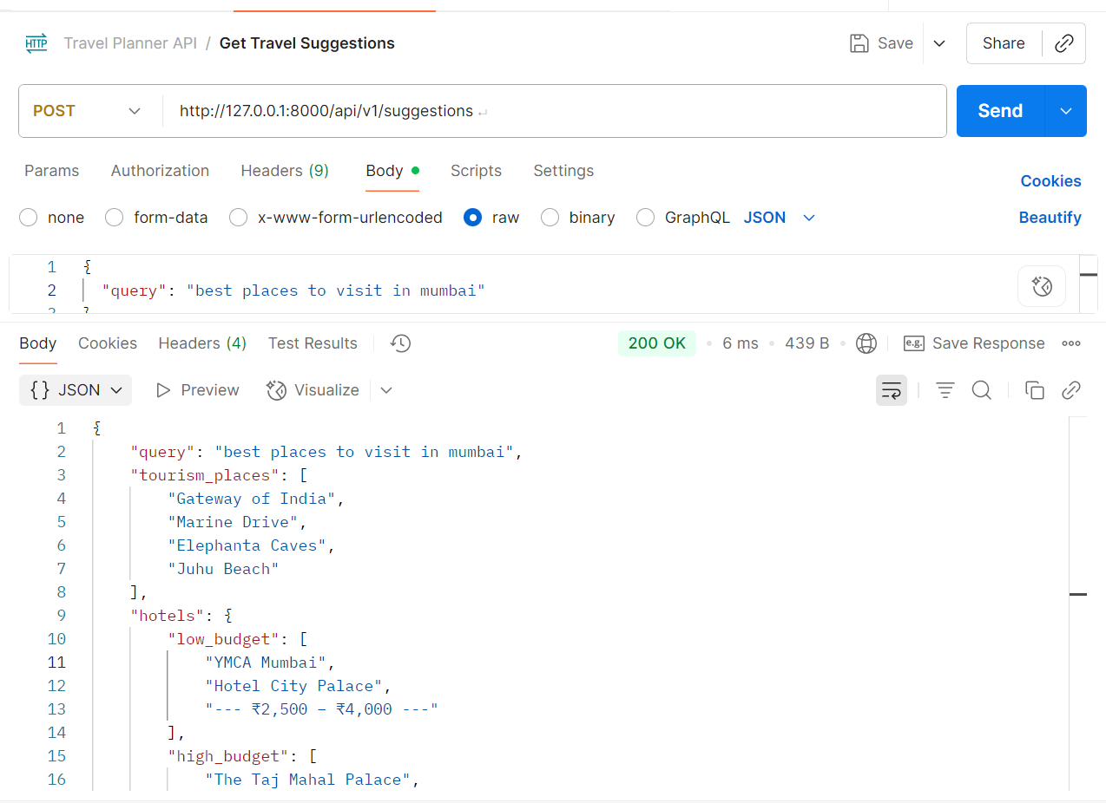
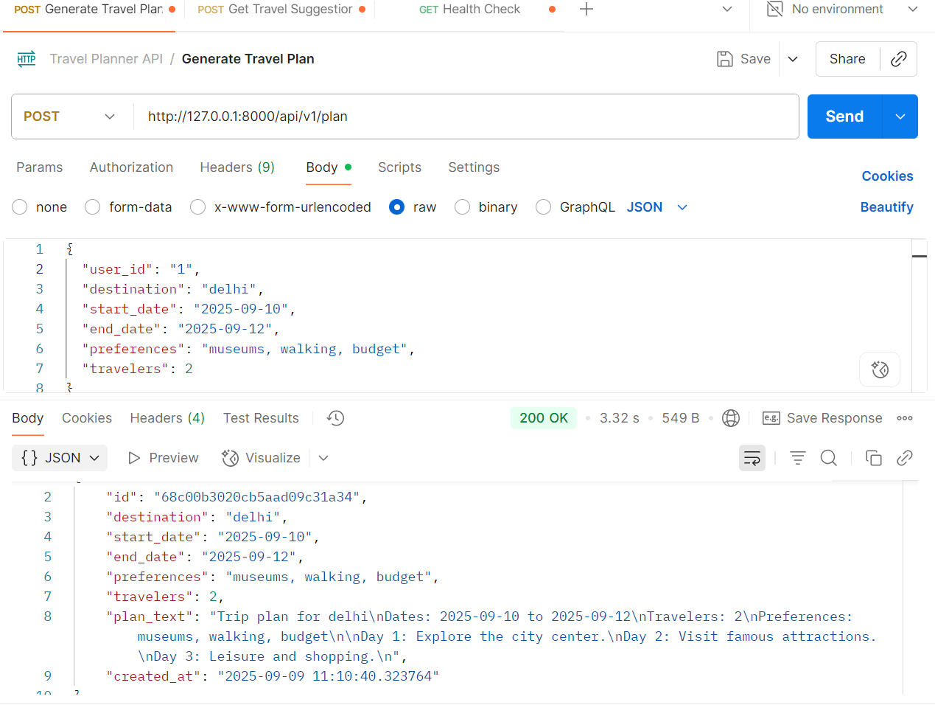
Postman API for Output
Intelligent AI-Based Travel & Tourism Planner

Slide 12

MongoDB
  I have used MongoDB for storing and managing application data efficiently.
  “All project data is efficiently stored and managed using MongoDB for scalability and flexibility.”
  MongoDB is used as the database to store and organize application data.
  I utilized MongoDB for flexible and scalable data storage.
Intelligent AI-Based Travel & Tourism Planner

Slide 13
CONCLUSION
Output
User
AI Generator
FastAPI
Database
The project successfully built an AI-based tourism planner that provides intelligent, real-time, and optimized itineraries. By combining AI algorithms, NLP, and API integration, it solves the problem of manual travel planning. This system can be scaled into a commercial-grade travel assistant application in the future.
PPT Deck Name
Intelligent AI-Based Travel & Tourism Planner

Slide 14

Future Scope
Integration with real-time APIs (flights, hotels, weather)
Voice-enabled AI travel assistant
Commercial scalability as a SaaS product
Expansion to global multi-language support
Advanced personalization using user behavior analytics
Intelligent AI-Based Travel & Tourism Planner

Slide 15
Thank You!!!

